Slide 1



Summer Internship Research Report
By: Mr. Sumeet Rodiya (BT22CSD054) & Vijay Patidar (BT22CSD037)
Under Supervision of : Dr. Jitendra Tembhurne
Subject: Deep-Fake Detection using Deep Learning.
Date : 15 June 2024

Slide 2
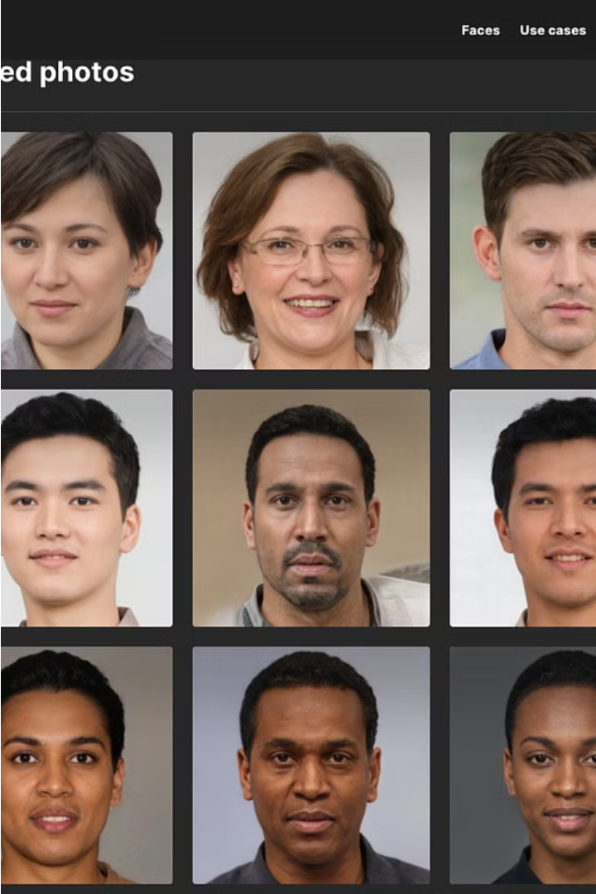
Introduction to Deepfakes
Deepfakes are synthetic media that use artificial intelligence (AI) to convincingly alter or generate realistic images and videos. This technology has become increasingly sophisticated, blurring the lines between reality and fabrication.

Slide 3
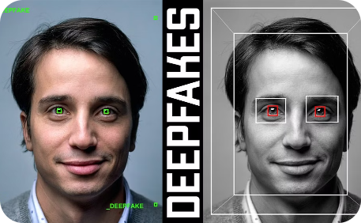

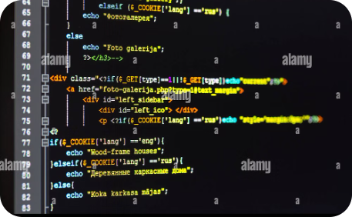
Abstract
Deepfakes
The Challenge of Deepfakes
Deep Learning for Deepfake Detection
Deepfakes are synthetic media generated using AI that replaces a person’s face with another’s. They often use deep learning algorithms to create realistic forgeries.
The growing prevalence of deepfakes poses significant threats, including the spread of misinformation, manipulation, and identity theft.
Deep learning techniques are being explored to detect deepfakes, leveraging neural networks trained on vast datasets to identify subtle anomalies.

Slide 4
Challenges in Detecting Deepfakes
1
Indistinguishable Insight
2
Evolving Techniques
Deepfakes are often extremely realistic, making it difficult to distinguish them from genuine content. The subtle clues that reveal a deepfake can be hard to detect by the human eye.
Deepfake technology is constantly evolving, leading to more sophisticated and undetectable fakes. This necessitates a continuous adaptation of detection methods to stay ahead of the curve.
3
Limited Training Data
4
Ethical Concerns
Creating robust deepfake detection models requires extensive training data. However, the availability of high-quality deepfake datasets is limited, making it challenging to train effective models.
Deepfake detection raises ethical concerns regarding privacy and freedom of expression. It is crucial to balance detection efforts with respecting individual rights.

Slide 5



Deepfake Detection using Deep Learning
Deep learning is a powerful tool for detecting deepfakes. Deep learning models can learn complex patterns in data and use this information to identify synthetic media. This approach is particularly effective in detecting deepfakes as it can capture subtle cues that human observers may miss.
Feature Extraction and Data Augmentation
1
Extracting relevant features from input data.
Model Training with proposed method
2
Training a deep learning model on a dataset of authentic and synthetic media.
Deepfake Detection Result
3
Using the trained model to classify new input data as real or synthetic.
Deep learning models have achieved promising results in detecting deepfakes. These models can identify subtle variations in facial expressions, lip movements, and other visual cues that distinguish real media from synthetic ones.

Slide 6
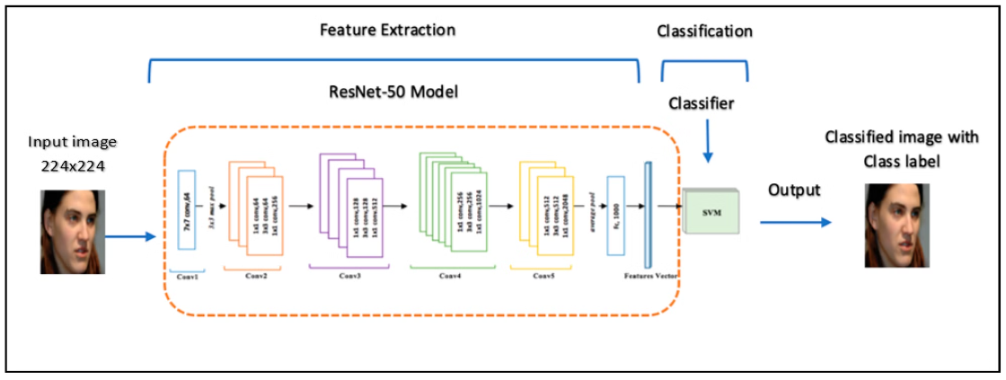
Deepfake Detection using CNN and its Disadvantages
Convolutional Neural Networks (CNNs) have shown promising results in detecting deepfakes by identifying visual anomalies in synthetic media. CNNs can effectively extract and analyze low-level visual features, such as texture, lighting, and facial characteristics, to differentiate real from fake content.
Disadvantages of CNN-based Deepfake Detection: However, CNN-based approaches have some limitations. They are primarily focused on static image analysis and may struggle to capture temporal inconsistencies in video-based deepfakes. Additionally, CNNs can be vulnerable to adversarial attacks, where deepfake creators can deliberately introduce subtle perturbations to bypass the detection system.

Slide 7

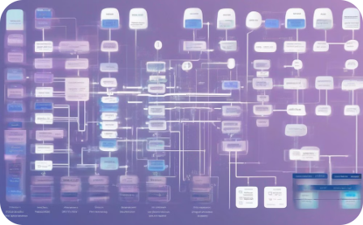

Proposed Attention-based LSTM with ResNet18 as Stacking Ensemble Method
Attention-based LSTM
ResNet18 Stacking
Ensemble Approach
By integrating an attention mechanism into the LSTM, the model can selectively focus on the most relevant temporal features for deepfake detection, improving overall performance.
Stacking the LSTM with a ResNet18 CNN allows the model to capture both temporal and spatial features, leveraging the strengths of each architecture for more robust deepfake detection.
The stacking of LSTM and ResNet18 creates an ensemble model, where the combined predictions lead to more accurate and reliable deepfake detection compared to individual models.

Slide 8
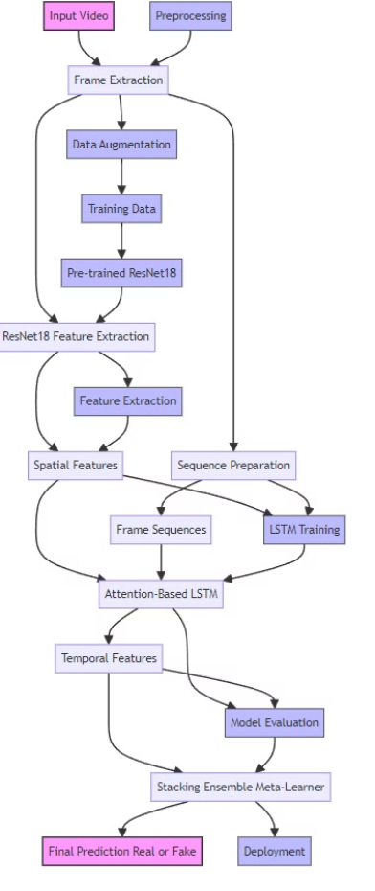
Model Architecture for Proposed Solution
This architecture combines the strengths of ResNet18 for extracting spatial features from video frames and an attention-based LSTM for capturing temporal dependencies within sequences of frames. Using a stacking ensemble method allows the model to leverage the complementary strengths of both models, resulting in a robust and accurate deepfake detection system.

Slide 9
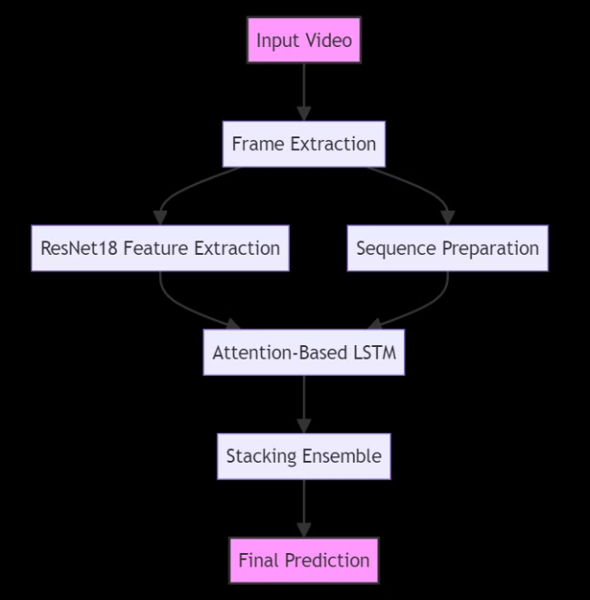






Long Short Term Model (LSTM) for Deepfake Detection
Here is a simple flowchart illustrating the process:
Feature Extraction
The model removes the final fully connected layer to use the remaining network as a feature extractor. The output is a high-dimensional feature vector representing each frame.
Sequence Preparation
The extracted features from consecutive frames are organized into sequences to capture temporal information. These sequences are fed into the LSTM model.
ResNet18 Model
A pre-trained ResNet18 model is used to extract high-level spatial features from each frame. ResNet18 is known for its efficiency and accuracy in image recognition tasks.
LSTM Architecture
LSTMs are a specialized type of RNN designed to handle long-term dependencies in data, crucial for analyzing the temporal changes in deepfakes.
Feature Extraction
LSTMs extract features from video sequences, learning patterns that distinguish real videos from deepfakes.
Classification
Based on extracted features, the LSTM model classifies each video frame as real or fake.

Slide 10
Deepfake Detection Model Framework
Long Short-Term Memory (LSTM)
1
LSTM networks are specifically designed to handle long-term dependencies in sequential data.
Heirachal Attention Mechanism (HAM)
An attention layer is integrated into the LSTM. This mechanism allows the model to focus on the most relevant parts of the sequence, enhancing its ability to identify important temporal features.
2
Stacking Ensemble Meta-Learner
A simple neural network (meta-learner) is trained on the outputs of the ResNet18 and LSTM models to learn the final decision boundary. This meta-learner aggregates the strengths of both models to improve prediction accuracy.
3
These neural networks have proven effective in capturing the subtle temporal patterns and dependencies inherent in deepfake videos, enabling more accurate detection.

Slide 11
Datasets and Benchmarks for Deepfake Detection
Deepfake Detection Datasets
Benchmarks and Evaluation Metrics
There are a variety of publicly available datasets used for training and evaluating deepfake detection models.
Researchers use various metrics to evaluate the performance of deepfake detection models.
Accuracy, Precision, Recall, and F1-score
FaceForensics++
Area Under the Receiver Operating Characteristic Curve (AUROC)
DeepFake Detection Challenge (DFDC)
Celeb-DF
Area Under the Precision-Recall Curve (AUPRC)
UADFV

Slide 12
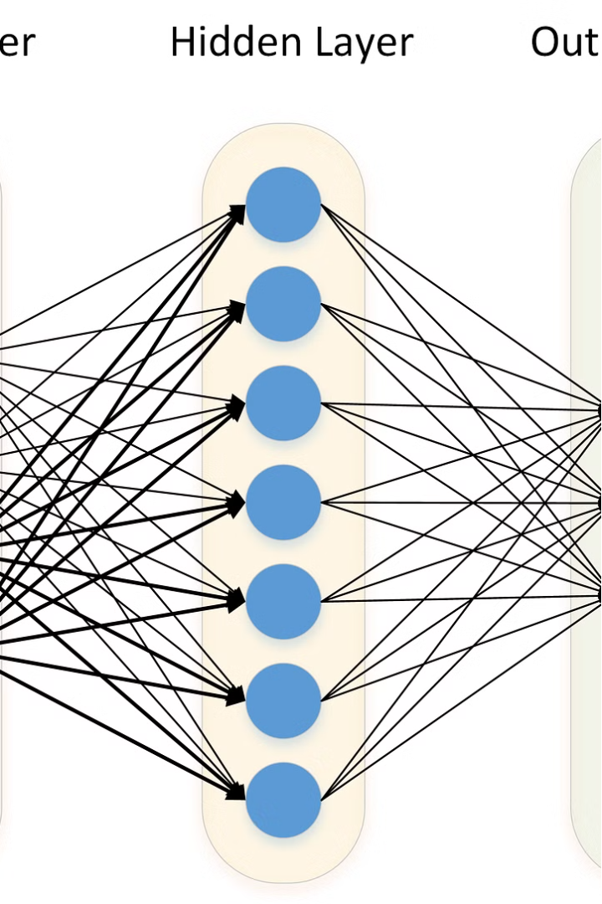
Model Architecture
Overview
The goal of the architecture is to combine the strengths of two powerful deep learning models—ResNet18 and an attention-based LSTM—using a stacking ensemble method to achieve high accuracy in deepfake detection. This approach leverages the ability of ResNet18 to extract spatial features from image frames and the capability of the LSTM to capture temporal dependencies in sequences of frames, with an attention mechanism enhancing the focus on important parts of the sequence.

Slide 13

Conclusion
1
Deepfake Detection Progress
Deep learning models have achieved significant progress in detecting deepfakes.
2
Future Research
Further research is needed to improve accuracy and robustness of these models.
3
Real-World Impact
Deepfake detection technology will play a crucial role in combating misinformation and safeguarding online security.

Slide 14
Future Trends and Considerations
Real-Time Deepfake Detection
Deepfake Forensics
Develop systems that can detect deepfakes in real-time, enabling immediate action to mitigate their impact.
Develop advanced techniques for identifying subtle artifacts and inconsistencies that can reveal the presence of deepfakes.
AI-Based Countermeasures
Ethical Considerations
Leverage AI to develop proactive solutions that can identify and neutralize deepfakes before they spread.
Address the ethical implications of deepfake technology, including potential misuse and the need for transparency.

Slide 15


